Slide 1
Development and validation of a serological assay for detection of Treponema pallidum
F022 – Biolab 2019
Andrew Lindsay
Supervisors: Tim Waterboer, Nicola Brenner, Rima Jeske

Slide 2
Agenda
Biology of syphilis and Treponema pallidum
T.pallidum reference assays
Quality controls – DNA, protein, binding
Validation of the assay
Comparison of sample population to the general population

Slide 3

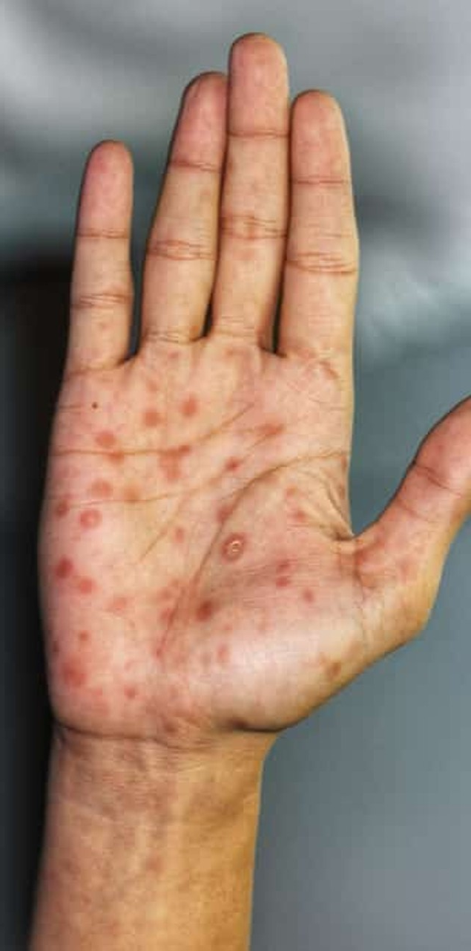
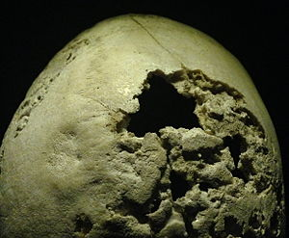
Syphilis
Brought to Europe by Christopher Columbus
Highly transferable – up to 30% of cases had contact with carrier in last 30 days
6 million new cases per year (WHO); > 90% occur in developing countries
Characterized by:
Lesions at site of contact, then spreading
Late-stage can infect head, brain, lungs, bone
Source: Hans Holbein the Younger
Source: Shutterstock
Source: Wikipedia
Notes:
Hans Holbein the Younger
Shutterstock
https://en.wikipedia.org/wiki/Neurosyphilis
An Update on the Global Epidemiology of Syphilis
Noah Kojima¹ and Jeffrey D Klausner^{1,2}

Slide 4
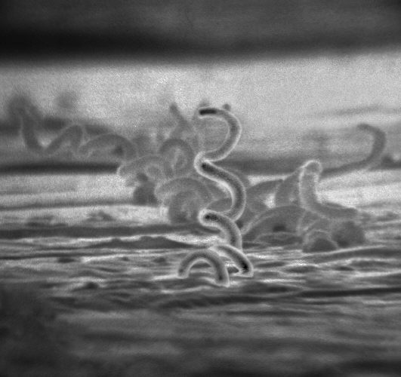
Treponema pallidum
Source: Wikipedia
Highly adapted to human internal enviroment
Three to six flagella ▶ allow invasion
Strictly extracellular ▶ high immune evasion
Very sensitive to penicillin
Treponema pallidum
Type: Spirochete, Gram⊝
Size: 6-15 μm x 0.1-0.2 μm
Genome: 1.14 Mbp
Infects: Only human
Culturable: No

Slide 5
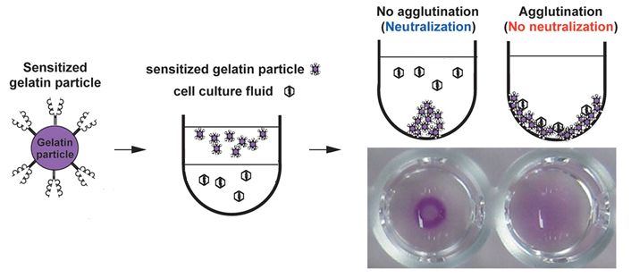
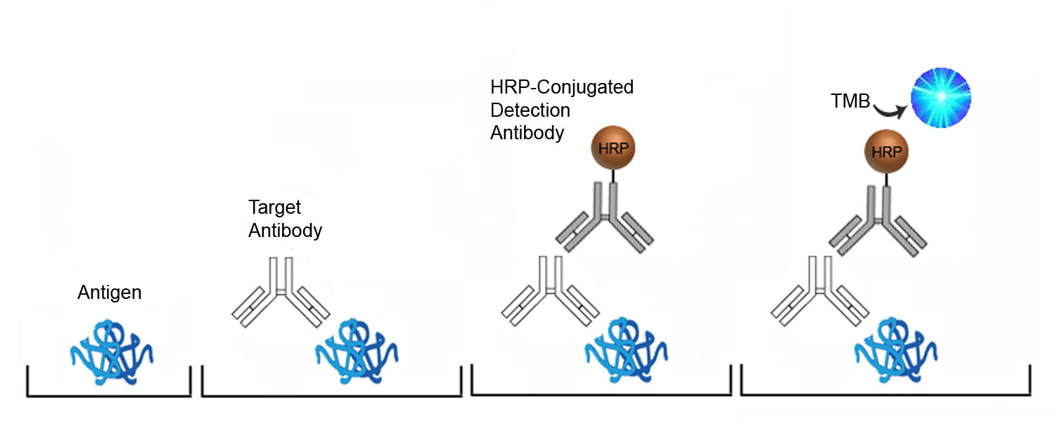
Reference Assays for Tp Proteins
Particle agglutination assay
SERODIA®-TP-PA by Fujirebio
Direct ELISA
recomLine Treponema IgG / IgM - Mikrogen
Modified from : Arita et al.
Source: LSBio
Source: Mikrogen
Notes:
Compare the two reference tests
https://jcm.asm.org/content/48/8/2698 Arita
https://www.lsbio.com/elisakits/mouse-anti-cardiolipin-antibody-igg-elisa-kit-indirect-elisa-ls-f10231/10231
https://www.mikrogen.de/english/products/product-overview/testsystem/treponema-igg-1.html

Slide 6
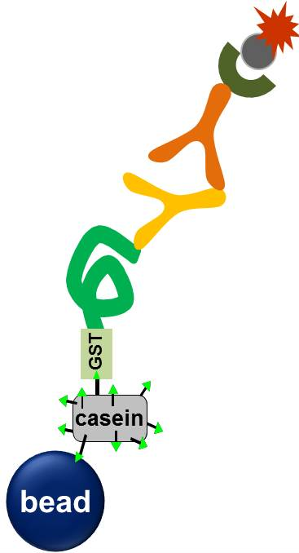
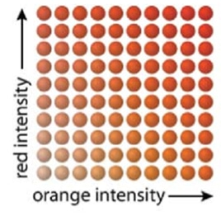

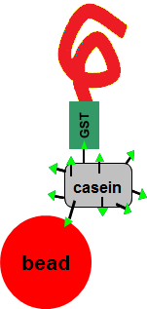
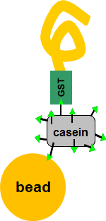
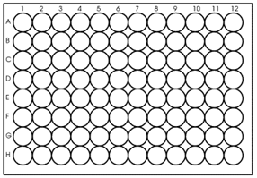

Principle of Multiplex Serology
streptavidin-R-phycoerythrin
biotin-labeled secondary antibody
bead mix
Tp species-specific GST fusion protein
1 serum / well
glutathione-casein
Luminex® bead
Source: Waterboer et al. 2005

Slide 7
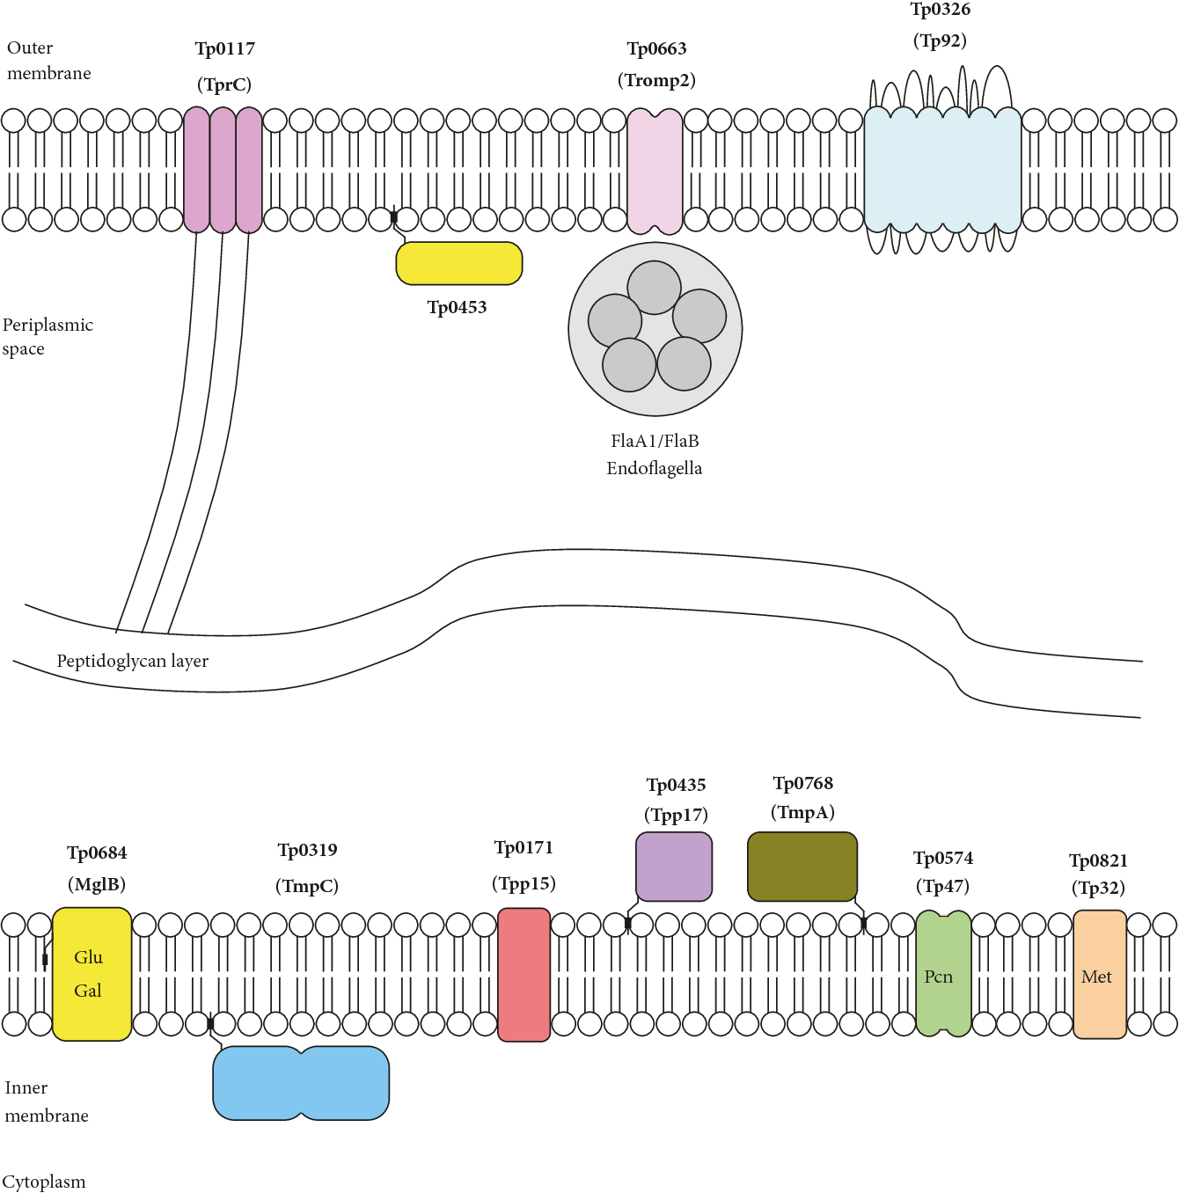
Treponema-specific Proteins
Outer membrane proteins highly variable
Low density of OM proteins (< 1%)
Two landmark reference studies: McGill et al. (IB), Brinkman et al. (ELISA)
4 highest reactivity: Tp15, Tp17, Tp44, Tp47
> 95% specificity and sensitivity, depending on stage of infection
Source: Kubanov et al. 2017
Notes:
Kubanov

Slide 8
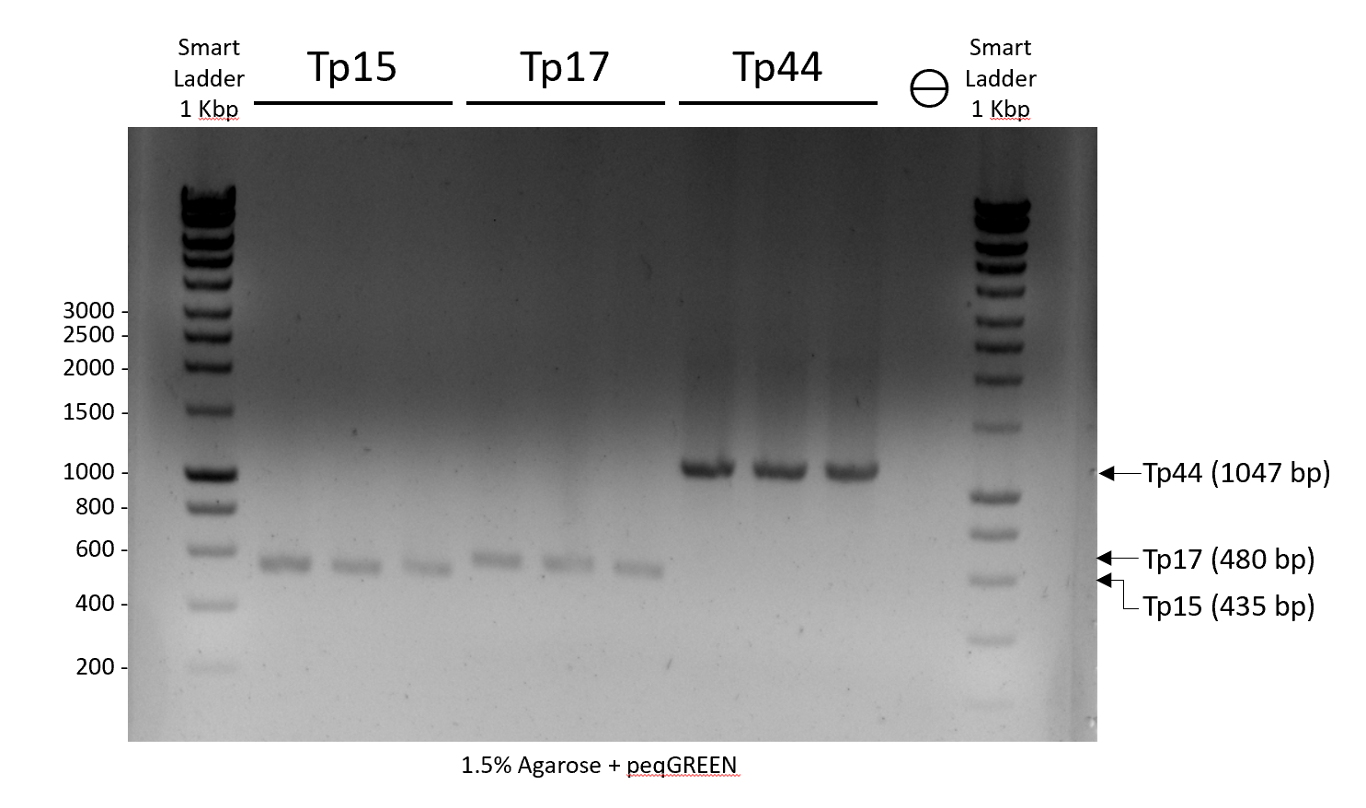
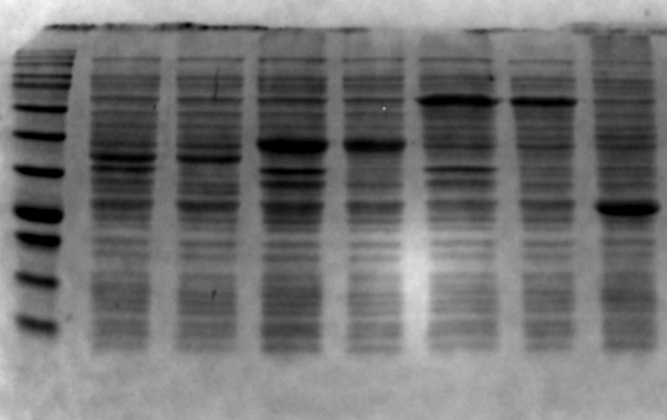
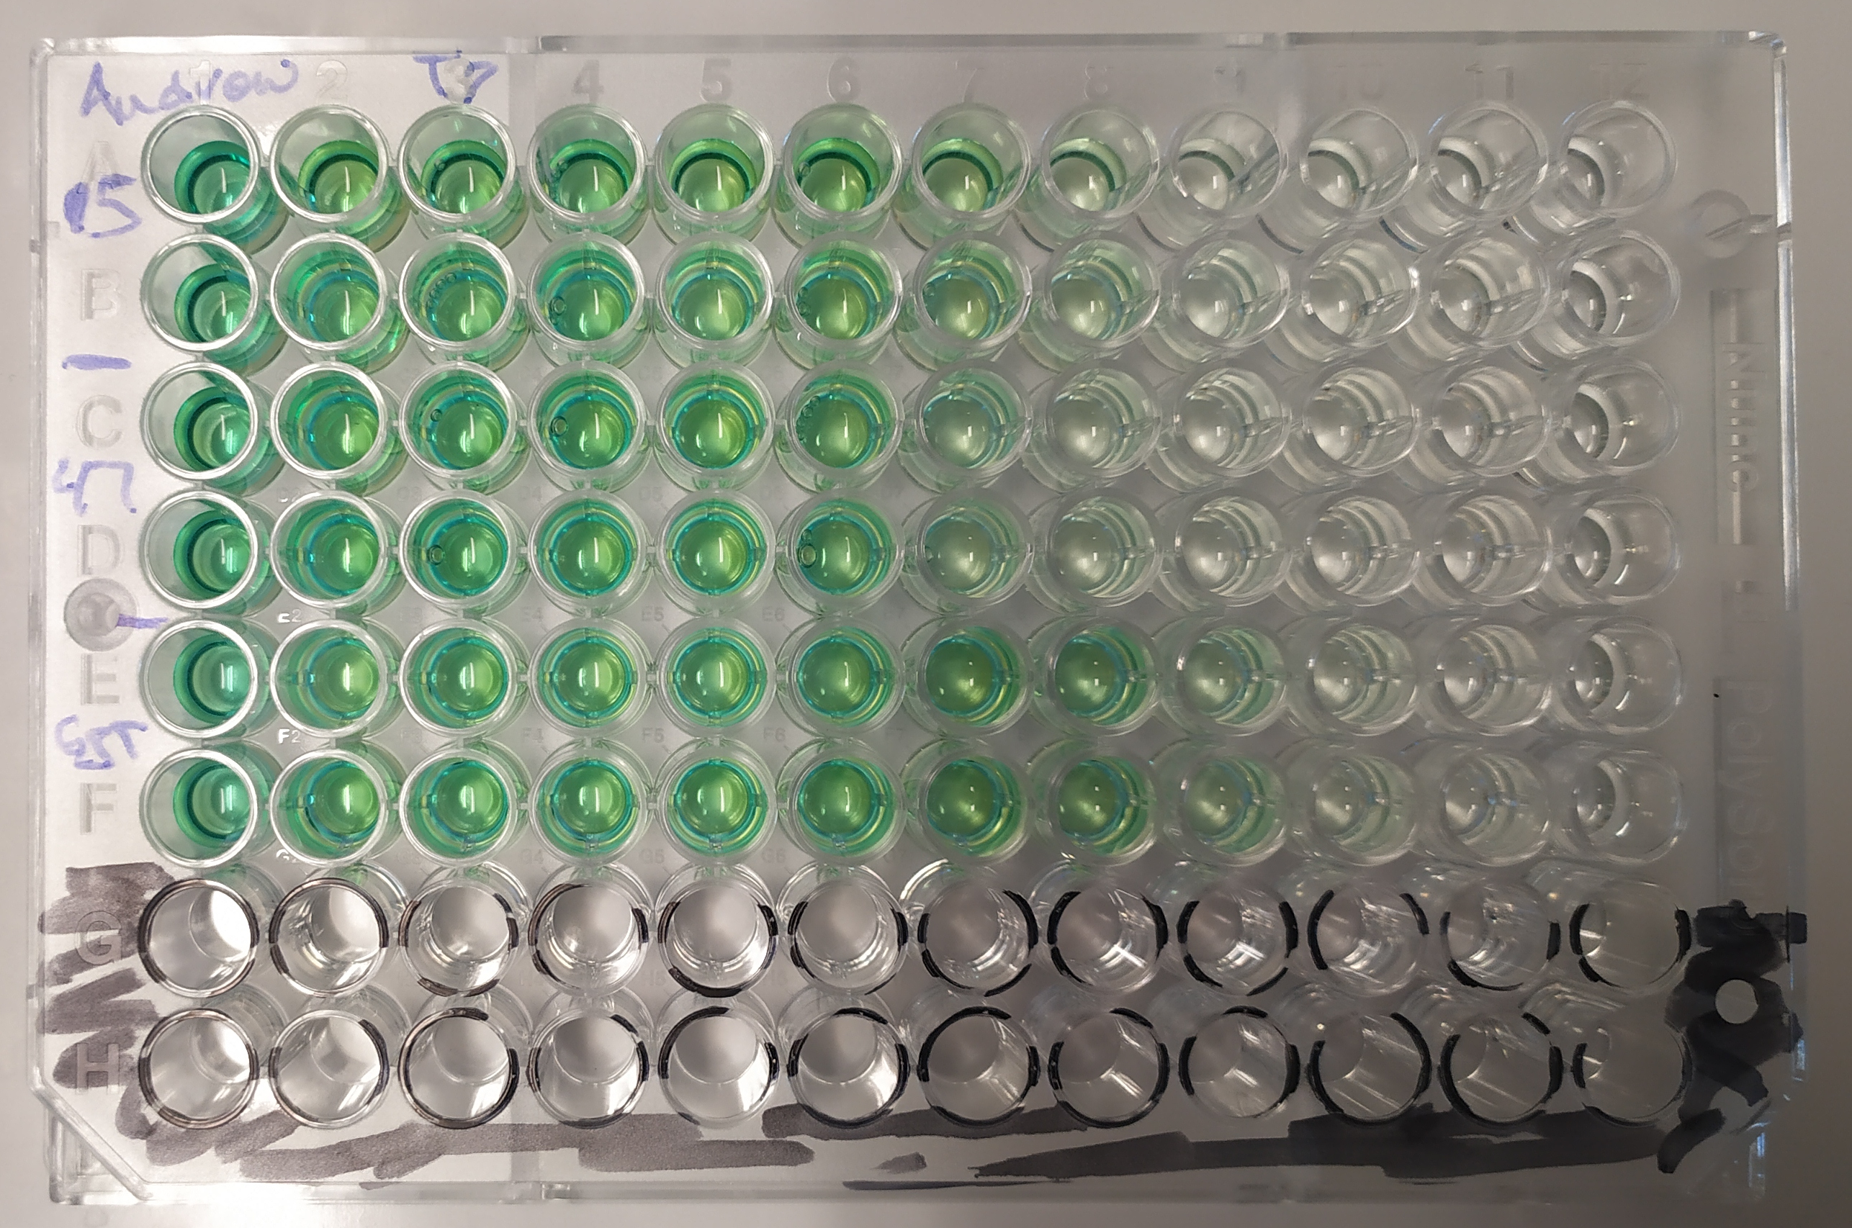
Development Quality Control
DNA ▶ PCR, Sequencing,
Restriction Digest
Binding ▶ ELISA
Protein ▶ Coomassie stain,
Western blot

Slide 9
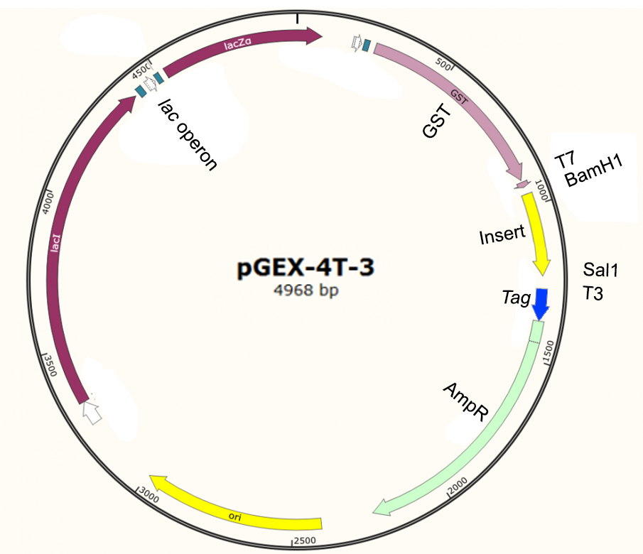

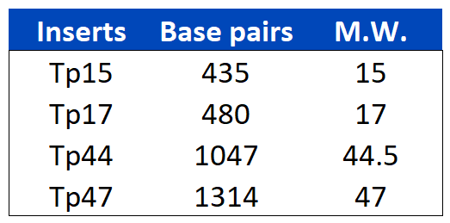
Plasmid construct for Tp proteins
Modified from: Eurofins

Slide 10
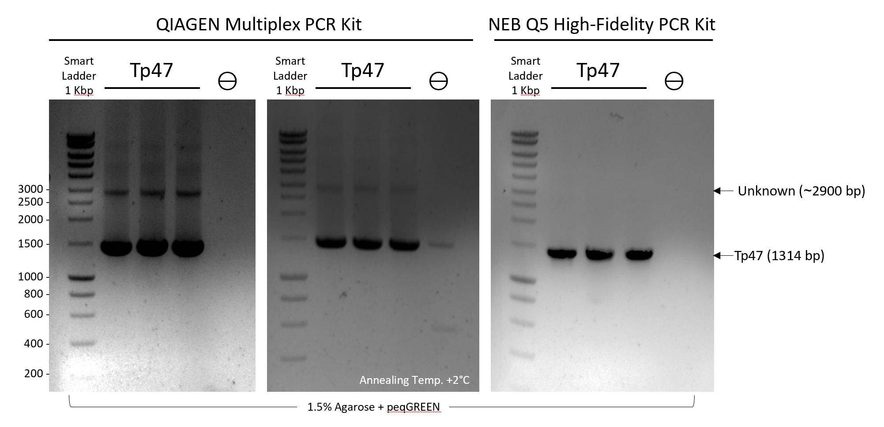
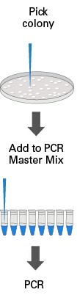
DNA Quality Control (Tp47)
Colony PCR
Second band present in PCR?
forming secondary structure?
dimeric configuration of product?

Slide 11
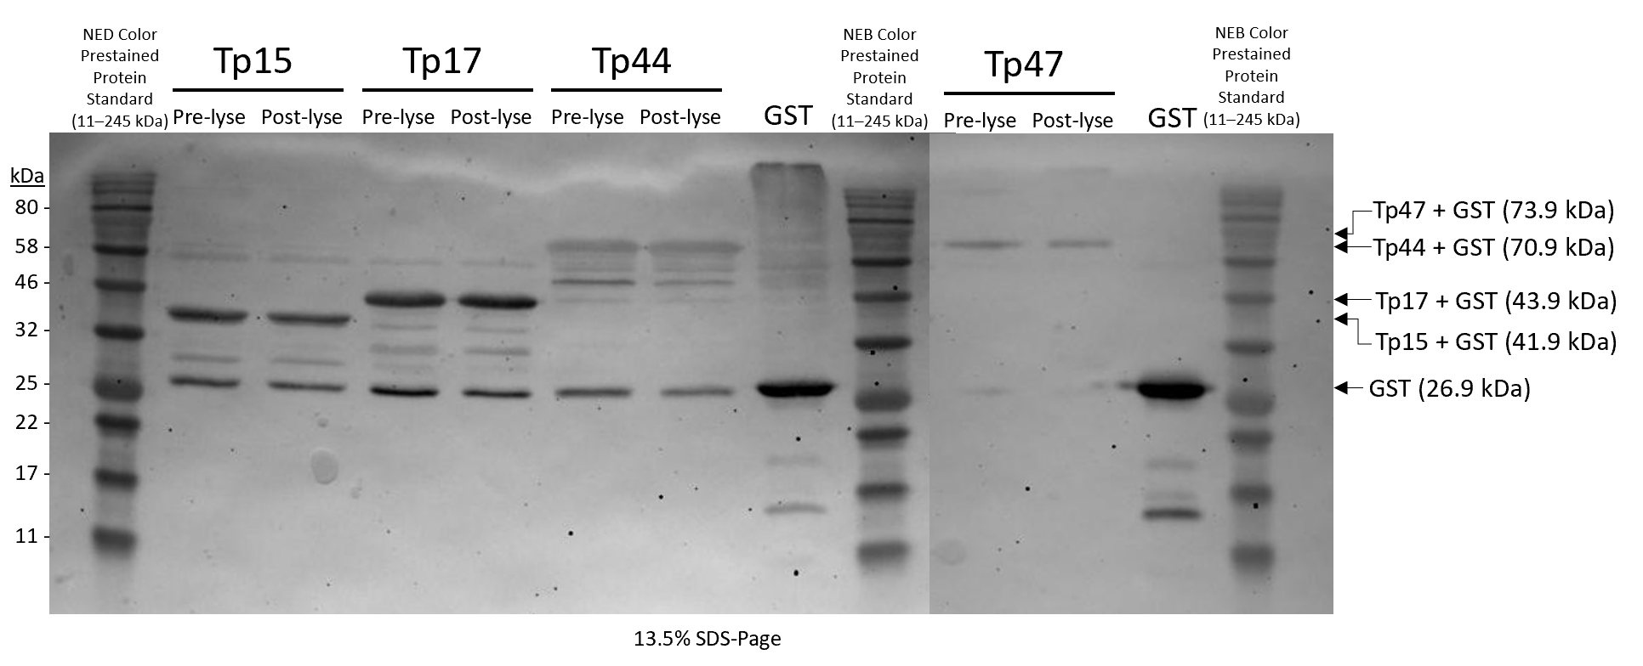
Protein Quality Control
Visible bands at expected sizes for Tp proteins
Some proteins are degraded during lysis

Slide 12
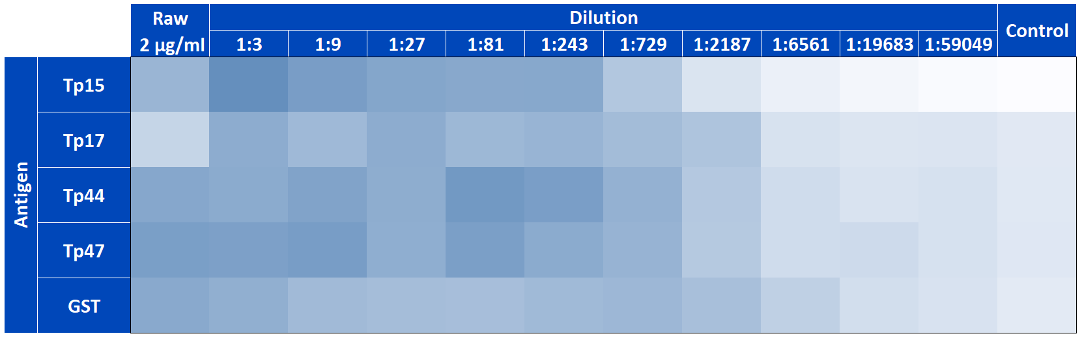
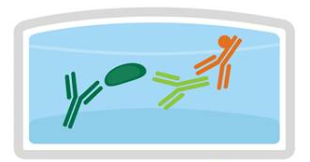
Binding Quality Control
Gradient ➞➞➞
GST-Tp-TAg
Anti-TAg
Glu-casein
POX
Binding at both ~1:100 and ~1:1000
Antigens should couple to the beadsets

Slide 13
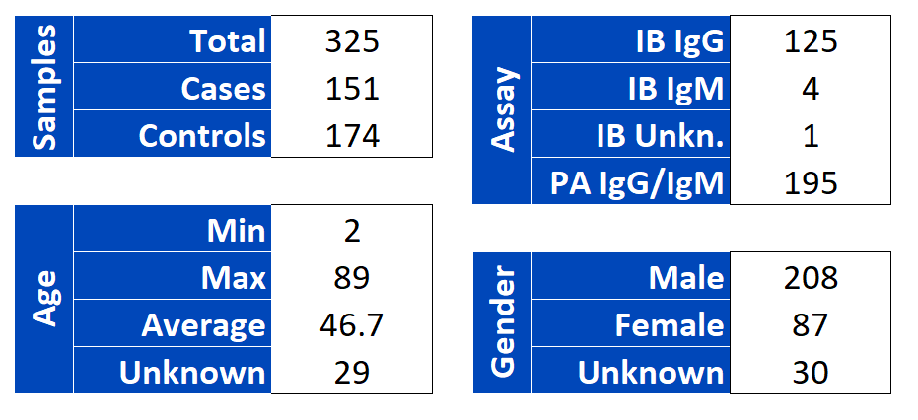
Cohort Characteristics
Patient sera obtained from Prof. Dr. Schnitzler ▶ consists of all samples taken from all syphilis tests done over the last 4 years at the Universitätsklinikum.

Slide 14
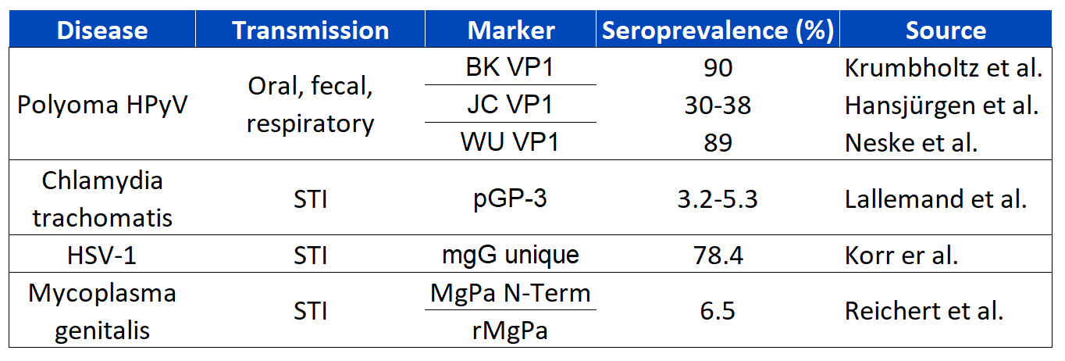
Control Antigens
Biased population ▶ test against control antigens
Hypothesis: Polyoma will have normal seroprevalence, STI’s will have elevated seroprevalence

Slide 15
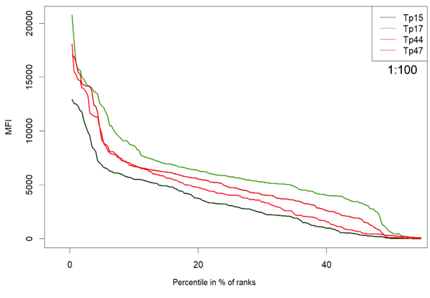
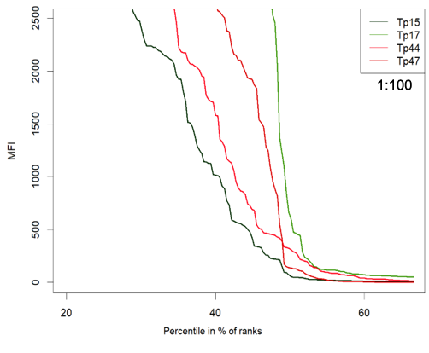
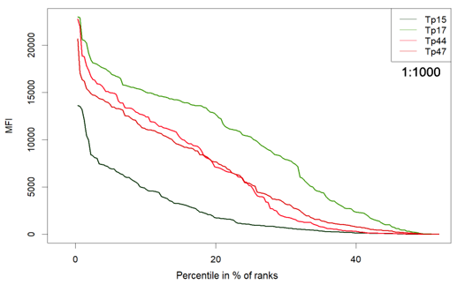
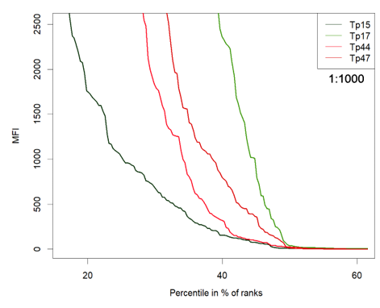
Visualizing Antigen MFI distribution
Threshold between positive and negative test ▶ Turning point method

Slide 16
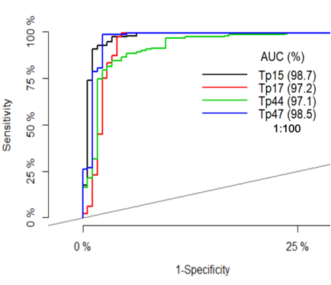
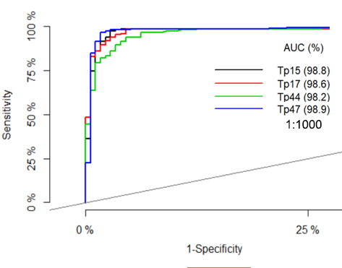
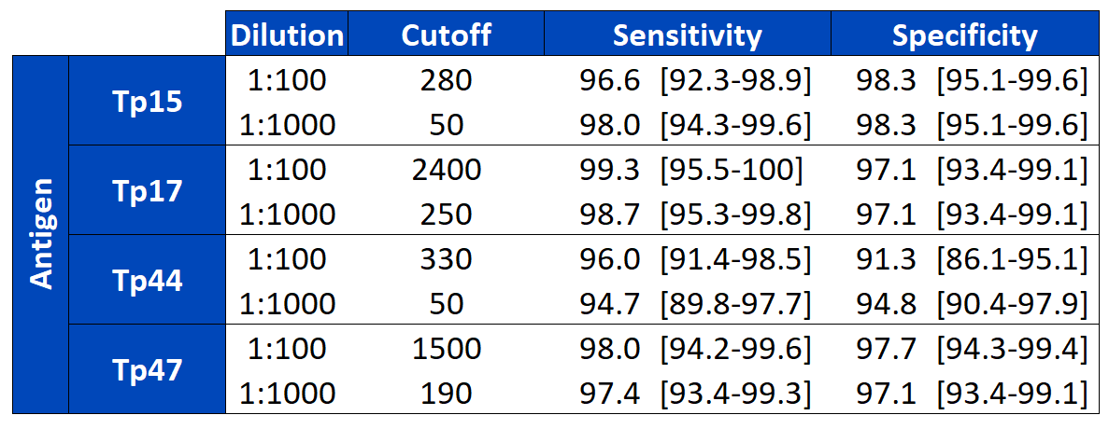
Calculating Initial Cutoffs for Antigens
Suspect biased sample ▶ Maximize with AUC curve

Slide 17
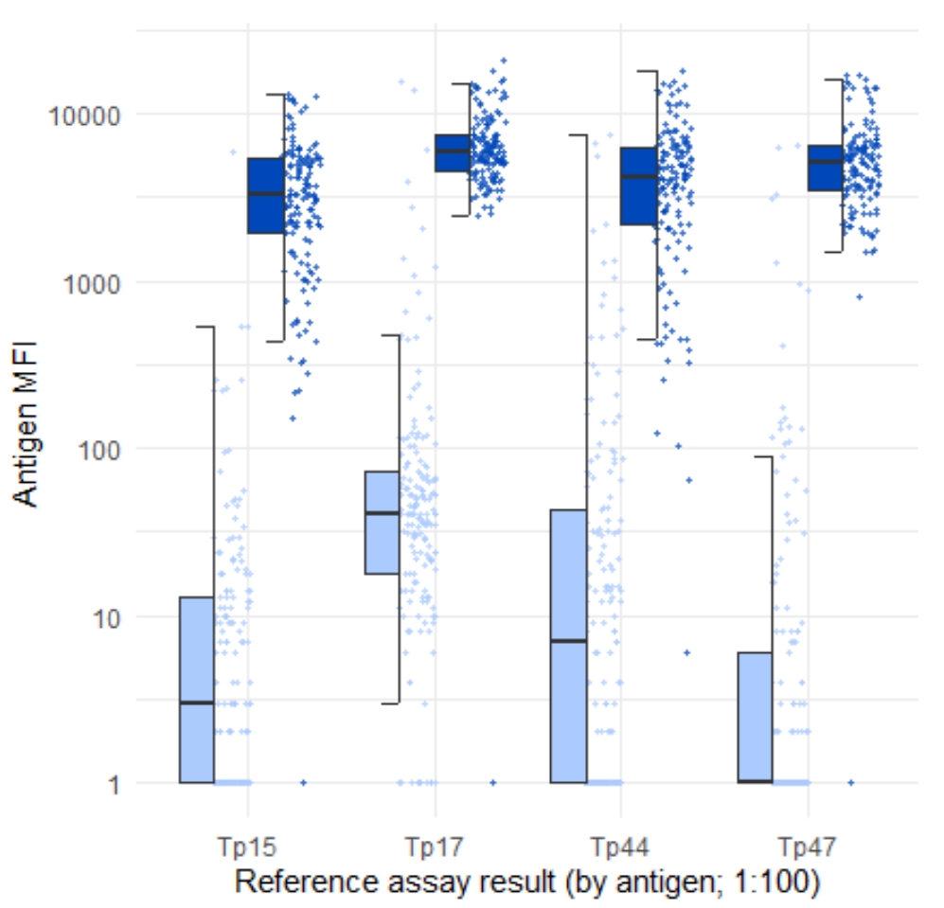
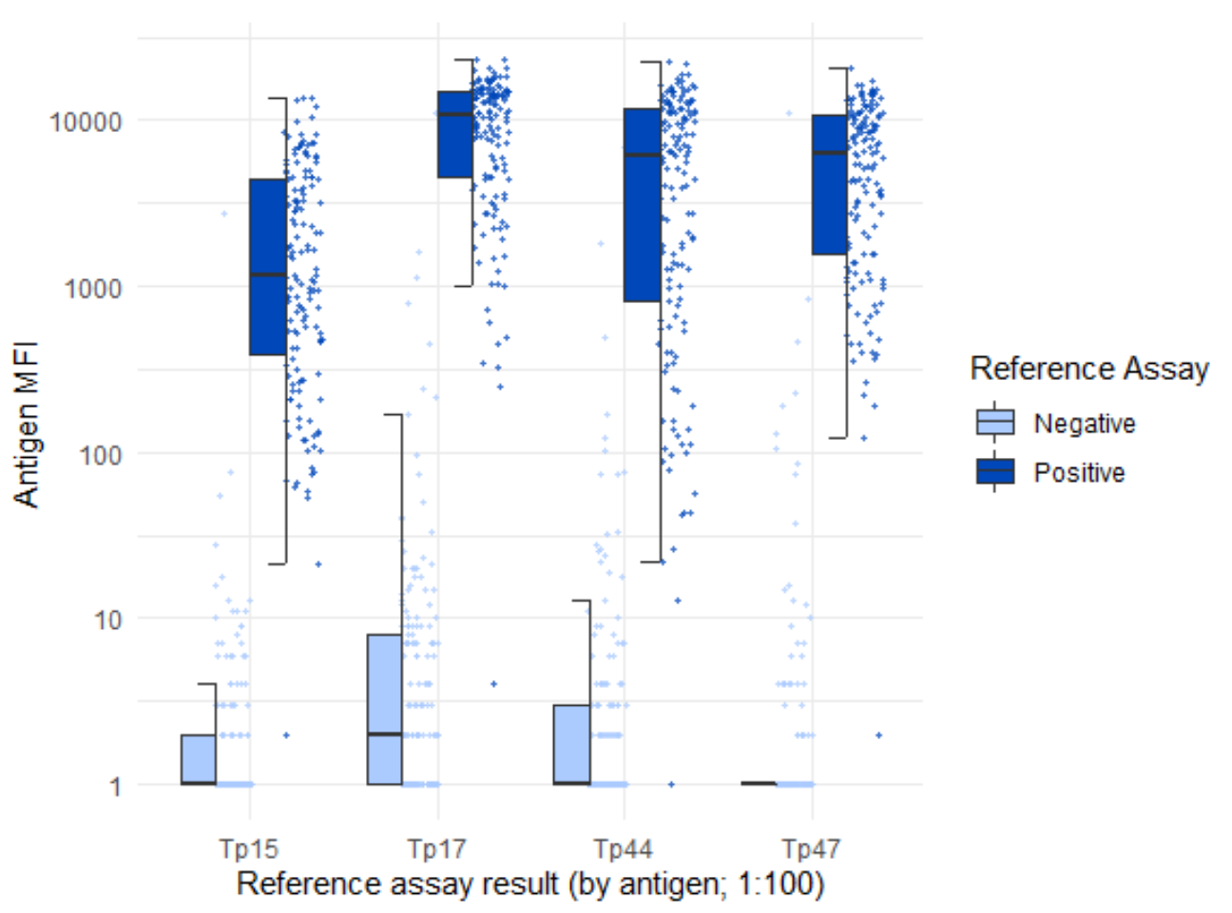
Cut-offs compared to Reference Assay
Generate AUC curves ▶ Maximize sensitivity and specificity
A
B

Slide 18
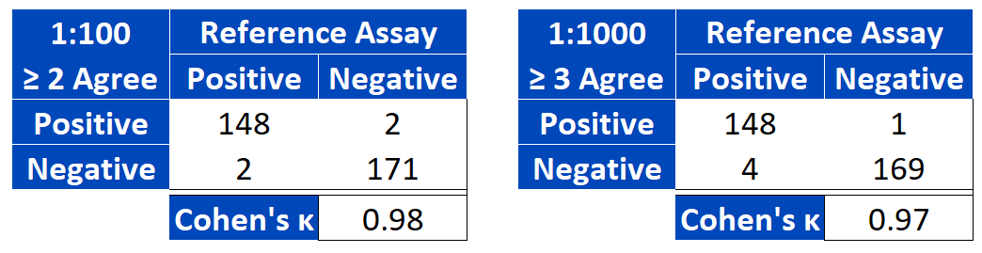
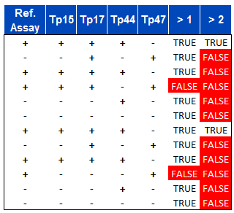
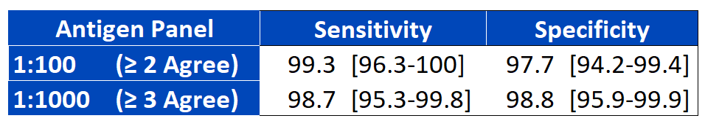
Optimization for Antigen Evaluation
Multiple antigens used ▶ Increased sensitivity and specificity
Take consensus from antigen cutoffs

Slide 19
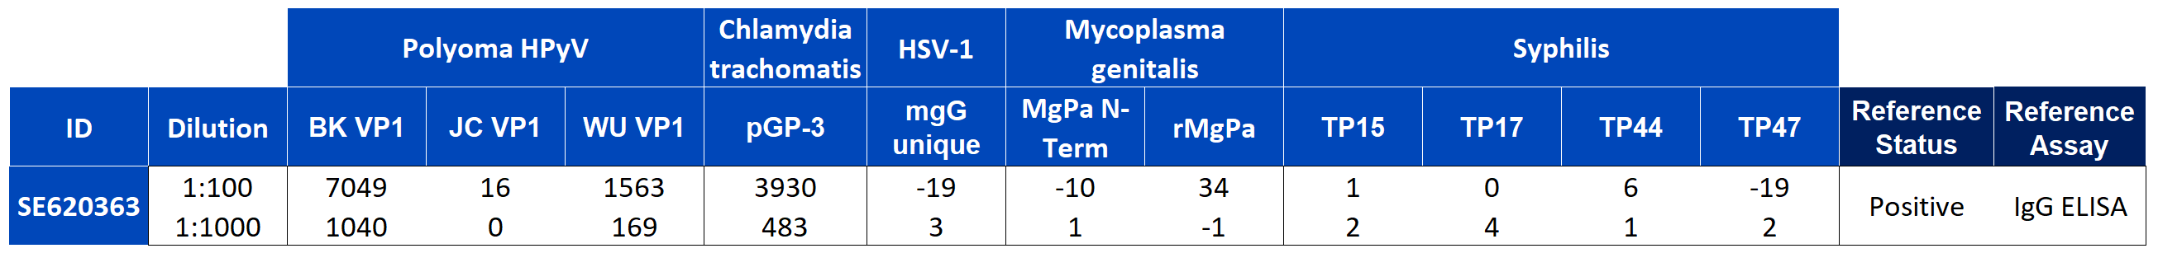
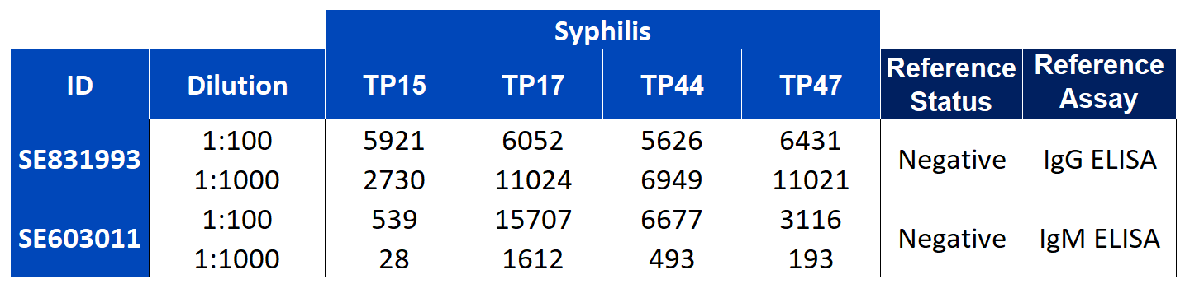
Confounding factors – extreme outliers
Positive samples with < 10x the cut-off:
Negative samples with > 10x the cut-off:
◀︎ Dilution problem
Notes:
https://www.researchgate.net/publication/265299545_Chronic_neuroborreliosis_by_B_garinii_An_unusual_case_presenting_with_epilepsy_and_multifocal_brain_MRI_lesions

Slide 20
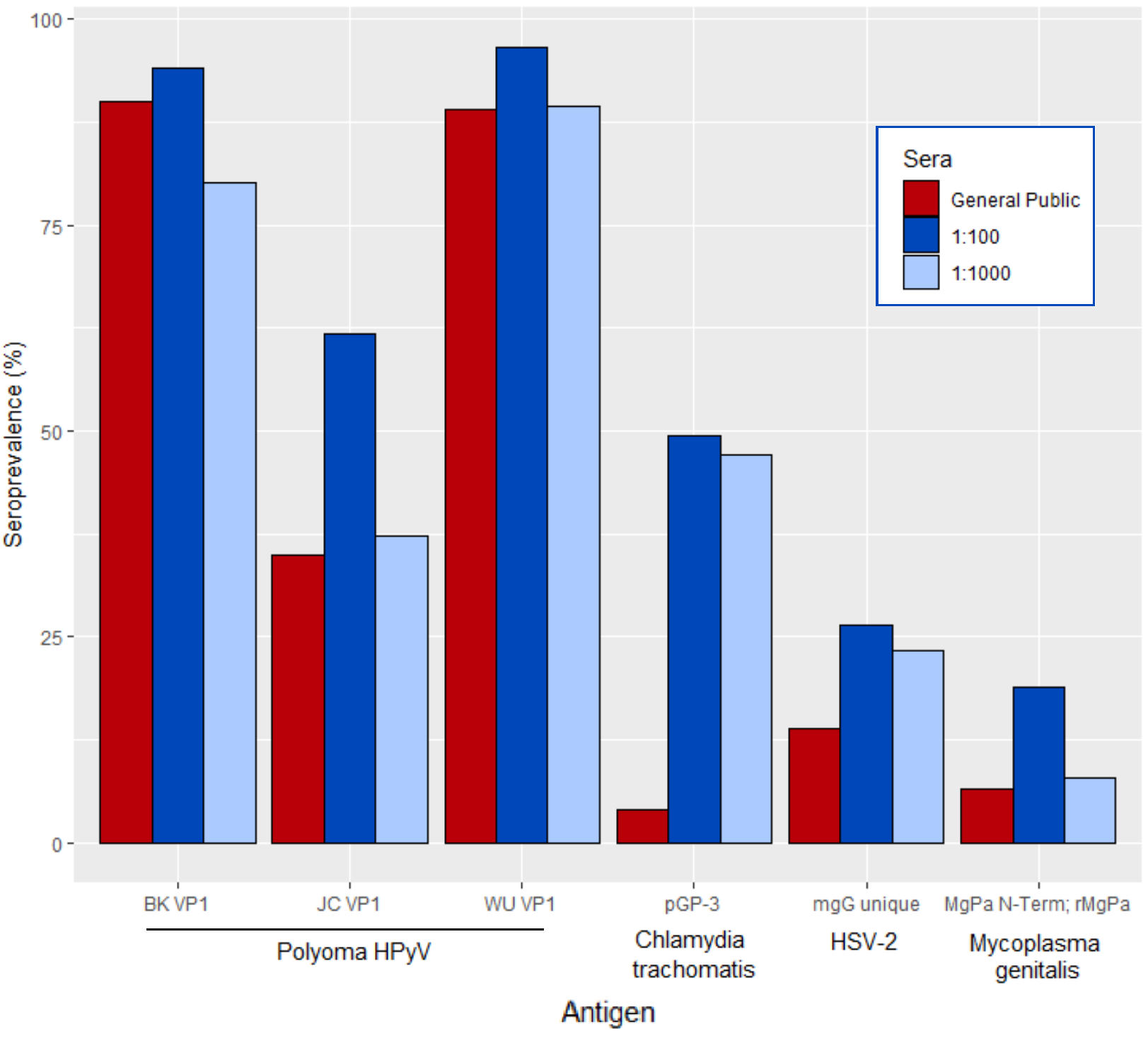
Control antigens in case-controls
STI prevalence elevated compared to the general public
Polyoma prevalence shows to be mostly uniform
Notes:
Prevalence of BK virus subtype I in Germany.
https://www.researchgate.net/publication/309465774_Prevalence_of_Chlamydia_trachomatis_infection_in_women_heterosexual_men_and_MSM_visiting_HIV_counselling_institutions_in_North_Rhine-Westphalia_Germany_-_should_Chlamydia_testing_be_scaled_up
Decreasing seroprevalence of herpes simplex virus type 1 and type 2 in Germany leaves many people susceptible to genital infection: time to raise awareness and enhance control.
High seroprevalence of Mycoplasma genitalium in the general adult population of Germany
Genotypes of JC virus in East, Central and Southwest Europe Hansju$rgen T. Agostini,1 Alison Deckhut,2 David V. Jobes,2† Rosina Girones,3 Gu$nther Schlunck,1 Marcin G. Prost,4 Carolina Frias,5 E. Pe!rez-Trallero,6 Caroline F. Ryschkewitsch2 and Gerald L. Stoner2
High prevalence of antibodies against polyomavirus WU, polyomavirus KI, and human bocavirus in German blood donors
Florian Neske,¹ Christiane Prifert,¹ Barbara Scheiner,¹ Moritz Ewald,¹ Jörg Schubert,¹ Andreas Opitz,² and Benedikt Weissbrich¹
The seroepidemiology of herpes simplex virus type 1 and 2 in Europe
FREE
R G Pebody1,

Slide 21
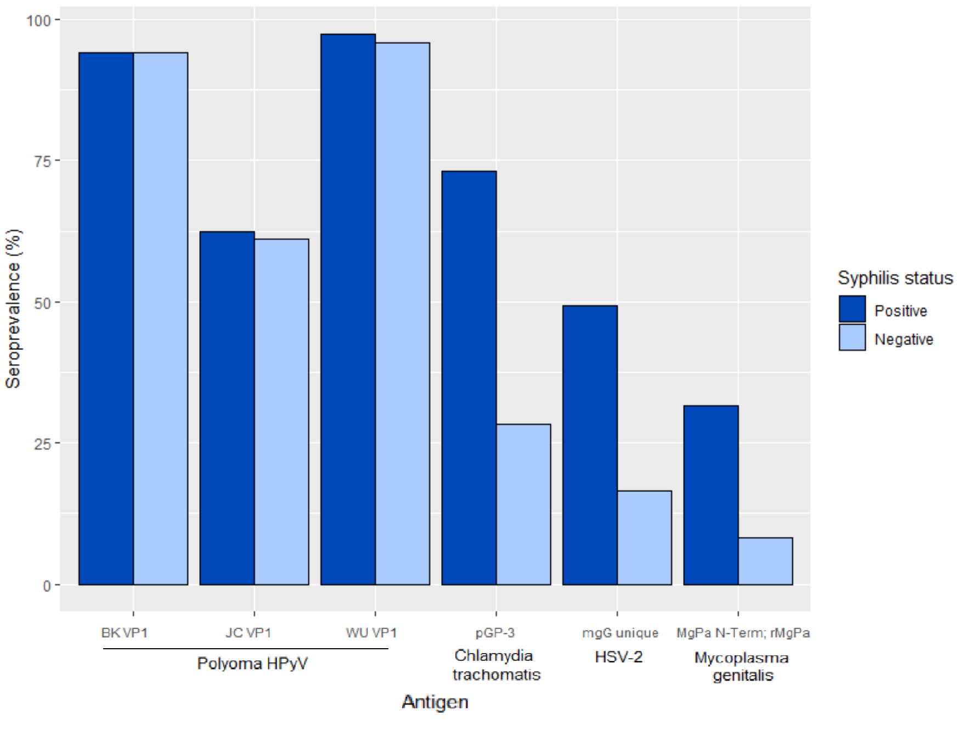
Control antigens between Syphilis +/-
STI’s are 3x more likely for Syphilis-positive
Polyoma is unchanged between the samples

Slide 22
Conclusions
Treponema proteins can be used successfully in multiplex serology
Sensitivity and specificity > 97%
Agreement of multiple antigens increases diagnostic power
Fewer false positives and false negatives
Sample population has similar non-STI infection rates
Polyoma consistent among samples
STI infection rates much higher in the sample population
~50% seroprevalence for Chlamydia
Syphilis-positive have 3x the STI infection rate

Slide 23
Thank you for your attention!

Slide 24
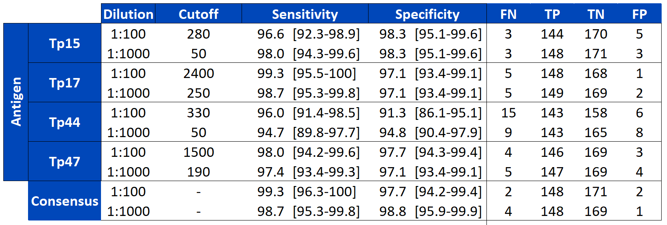

Slide 25
Treponema pallidum
Source: Wikipedia
Highly adapted to human internal enviroment
Three to six flagella ▶ allow invasion
Strictly extracellular ▶ high immune evasion
Very sensitive to penicillin
Treponema pallidum
Type: Spirochete, Gram⊝
Size: 6-15 μm x 0.1-0.2 μm
Genome: 1.14 Mbp
Infects: Only human
Culturable: No

Slide 26
Reference Assays for Tp Proteins
Particle agglutination assay
SERODIA®-TP-PA by Fujirebio
Sensitivity: 87-100%
Specificity: 95%
Unknown antigens
4 wells per sera per antigen
Visual interpretation
Direct ELISA
recomLine Treponema IgG / IgM - Mikrogen
Modified from : Arita et al.
Sensitivity: 100%
Specificity: 100%
Six Tp antigens: Tp15, Tp17, TmpA (Tp44), Tp47, Tp257 (Gpd), and Tp453
20 antigen maximum
Large test strips (5cm x 3mm)
Visual or scan interpretation
Source: LSBio
Source: Mikrogen
Notes:
Compare the two reference tests
https://jcm.asm.org/content/48/8/2698 Arita
https://www.lsbio.com/elisakits/mouse-anti-cardiolipin-antibody-igg-elisa-kit-indirect-elisa-ls-f10231/10231
https://www.mikrogen.de/english/products/product-overview/testsystem/treponema-igg-1.html

Slide 27
PCR QC (Tp15, Tp17, Tp44)
Colony PCR
Inserts are flanked by T3 and T7 promoter sites ▶ PCR
All bands showing at the expected size
Modified from: Takara
Notes:
https://www.takarabio.com/learning-centers/pcr/technical-notes/colony-pcr-in-under-an-hour

Slide 28
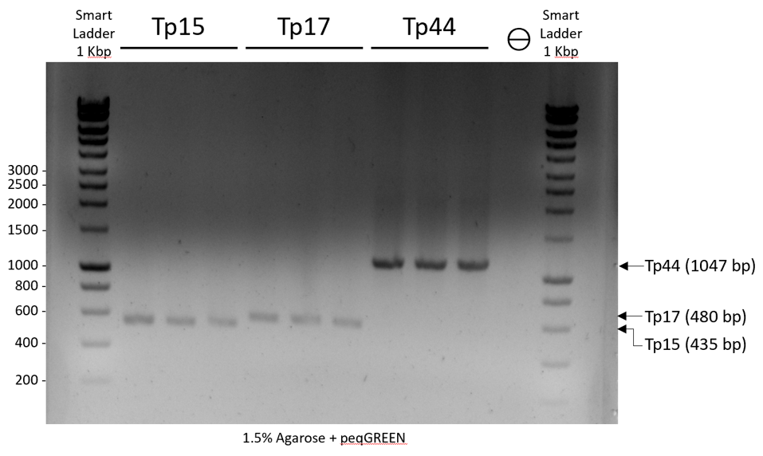

Slide 29
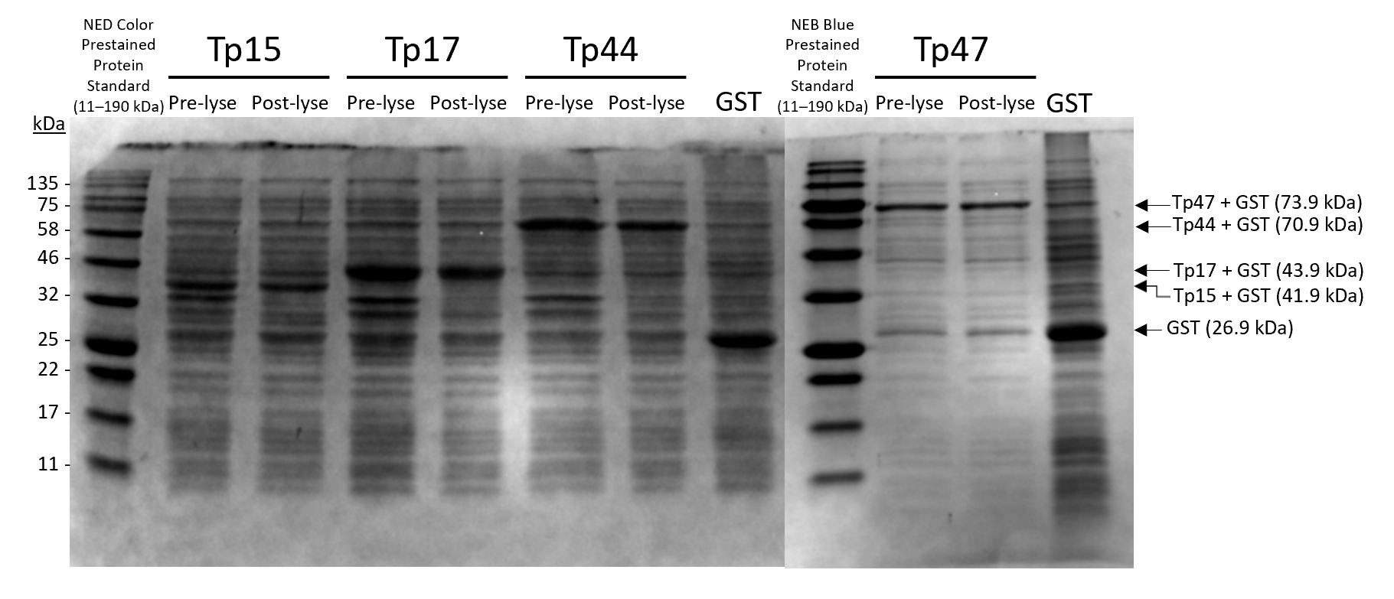
Coomassie Stain QC
Pre-sequencing ▶ PCR clean-up to remove primers, polymerase, etc
Strong bands at expected sizes for Tp proteins
Some proteins are degraded during lysis

Slide 30
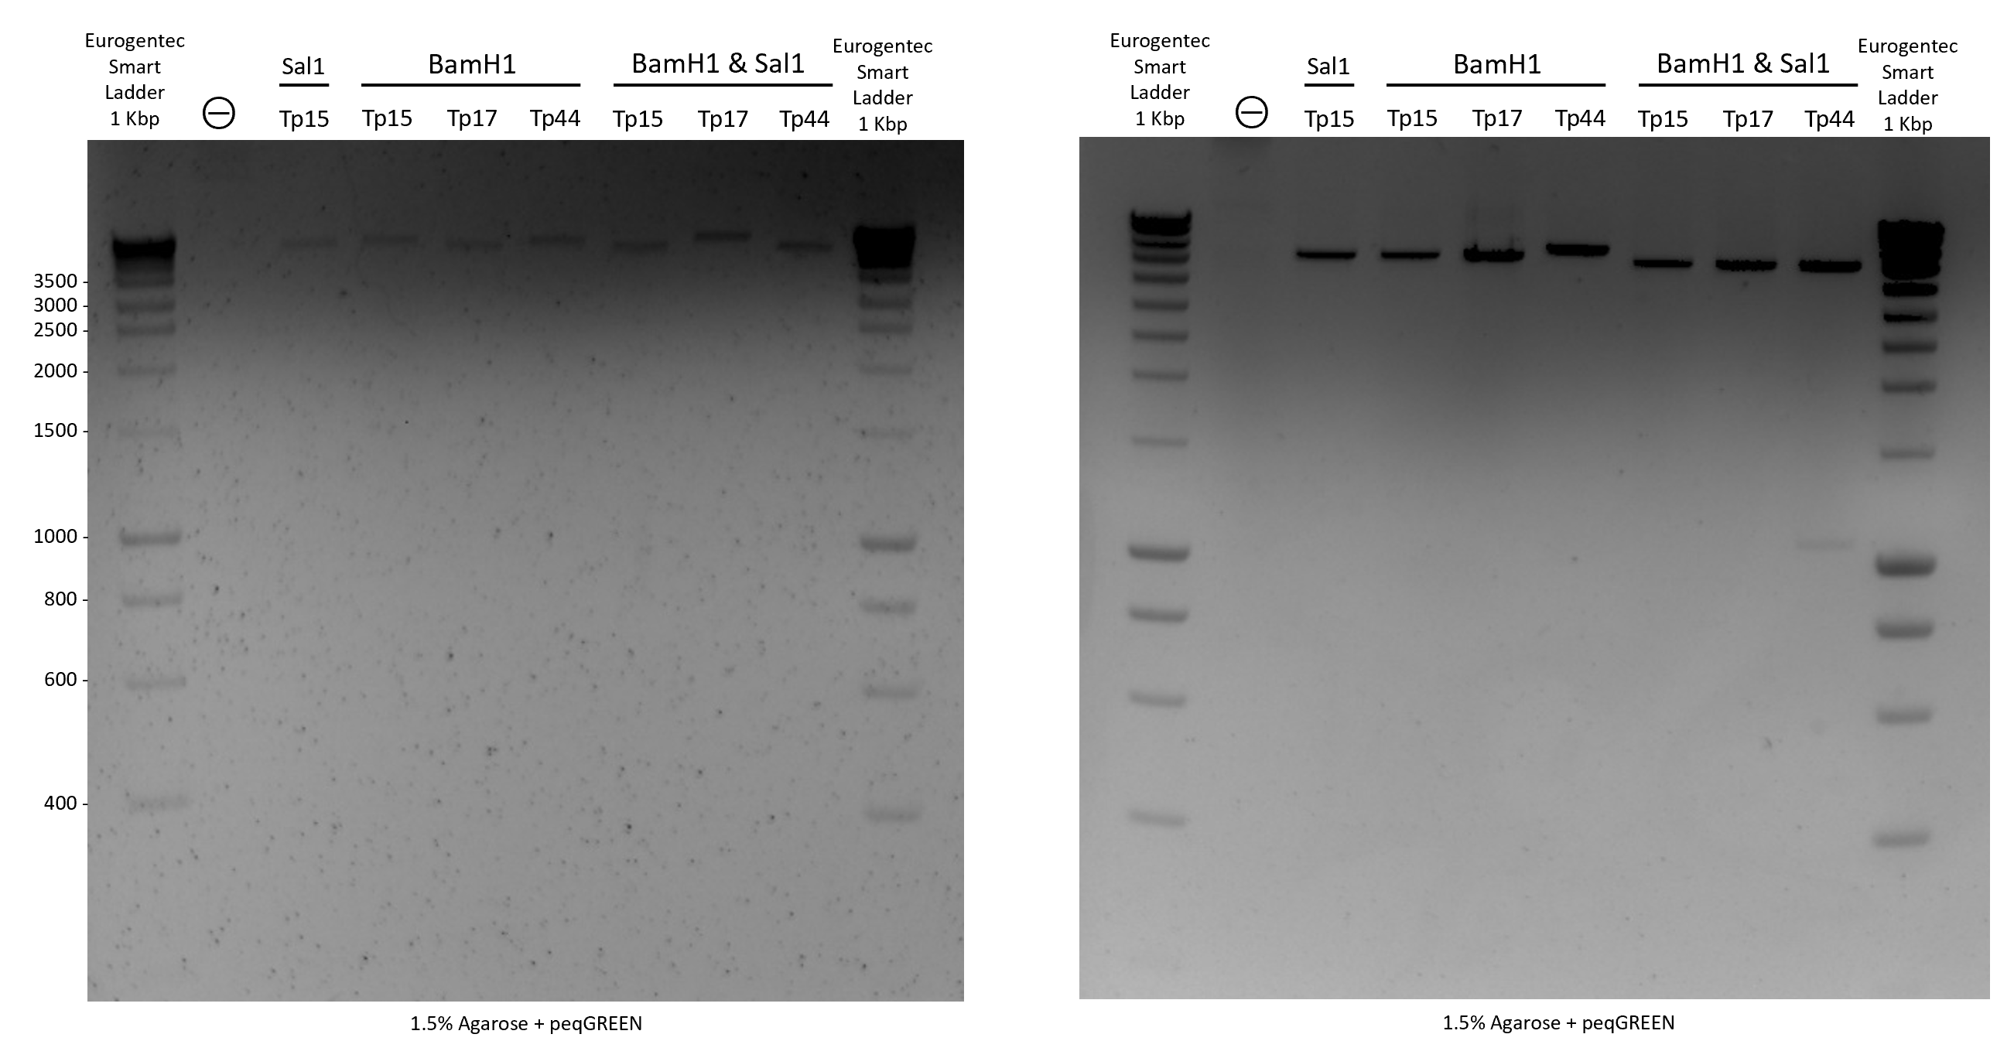
Restriction Digest
BamH1 and Sal1 flank the insert region ▶ linear and symmetric digestion
Restriction Sites
Minimal Digestion? Bad enzymes? Bad reaction buffer?

Slide 31
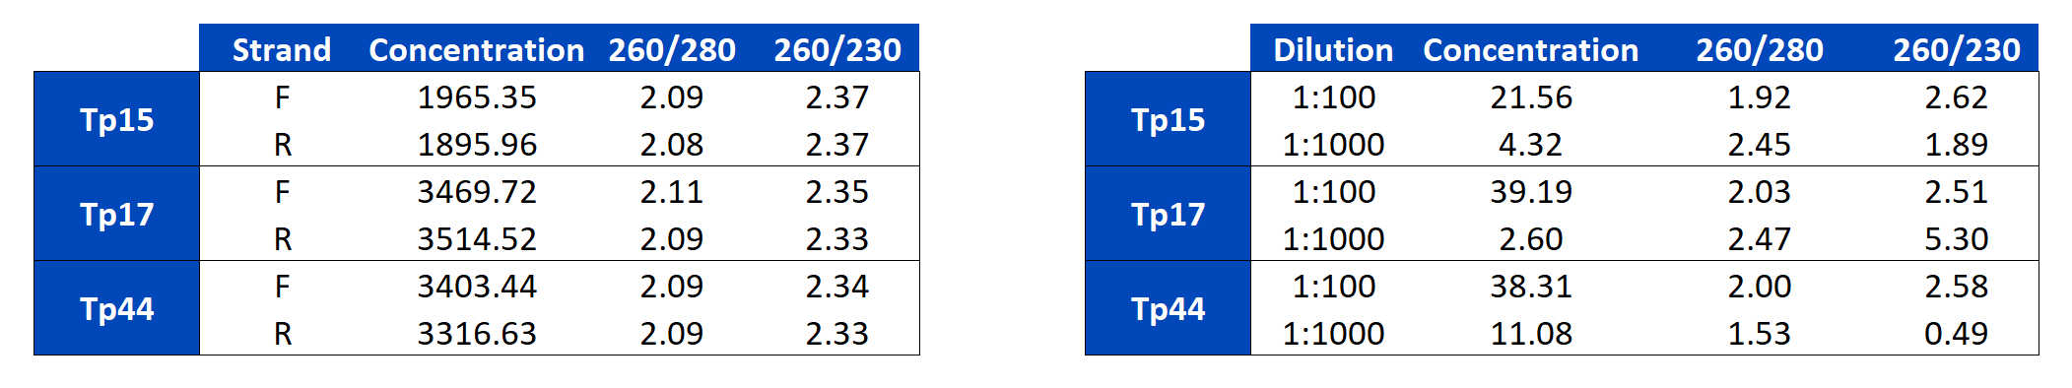
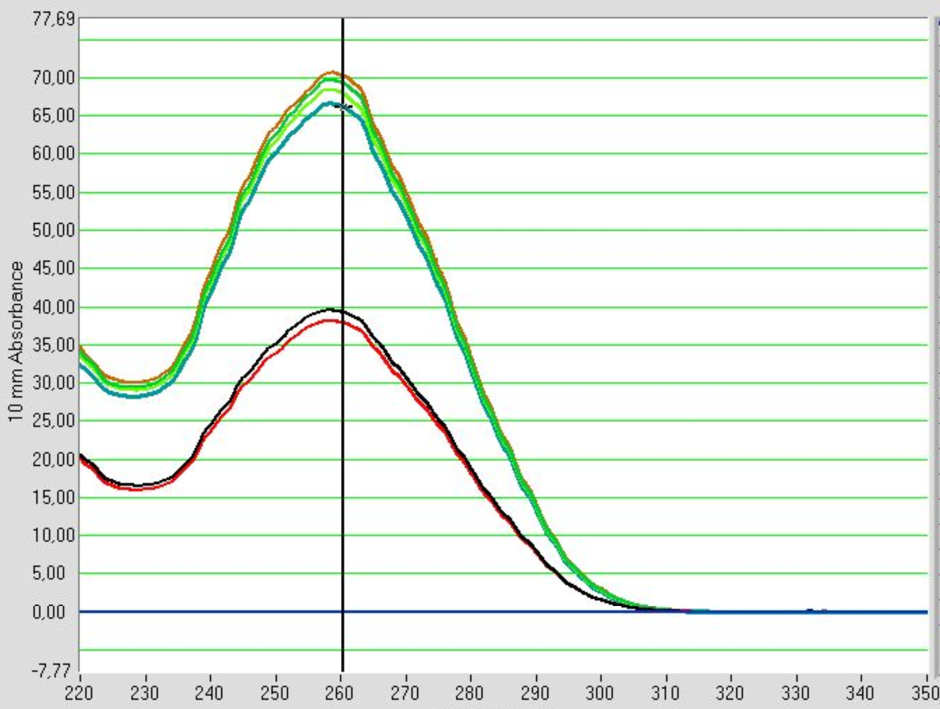
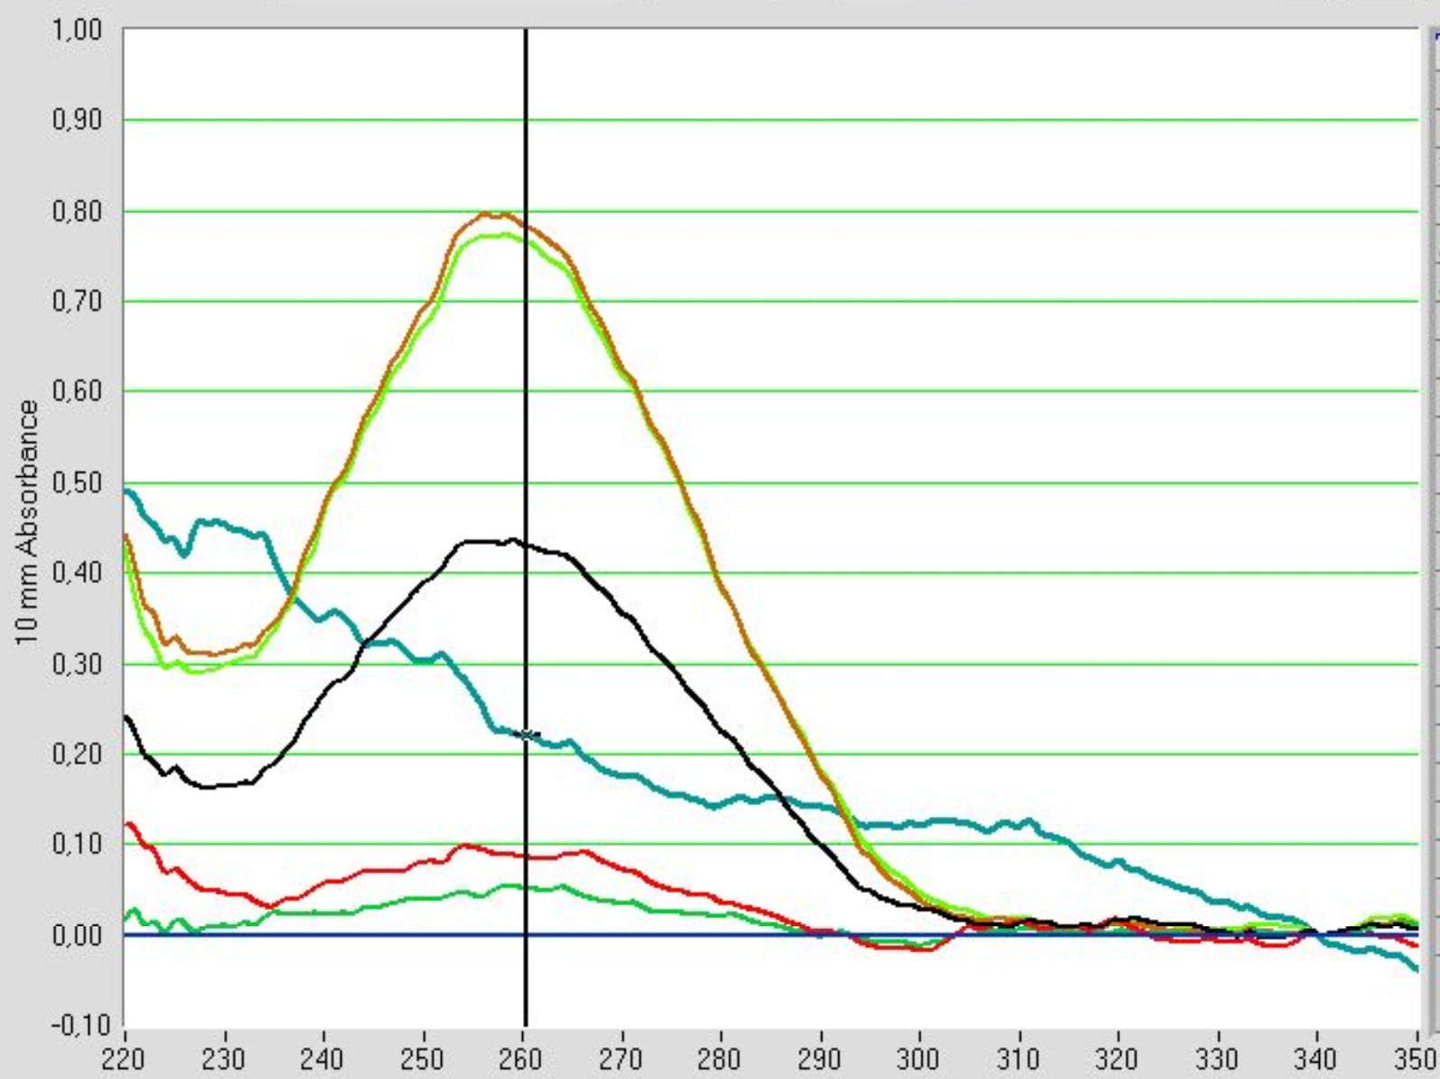
Preparation for Sequencing
Pre-sequencing ▶ Concentration and quality were verified
Tp17
Tp44
Tp17
Tp44
Tp17
Tp17
Sequencing was very low quality (90% of bases <= 10 quality)

Slide 32
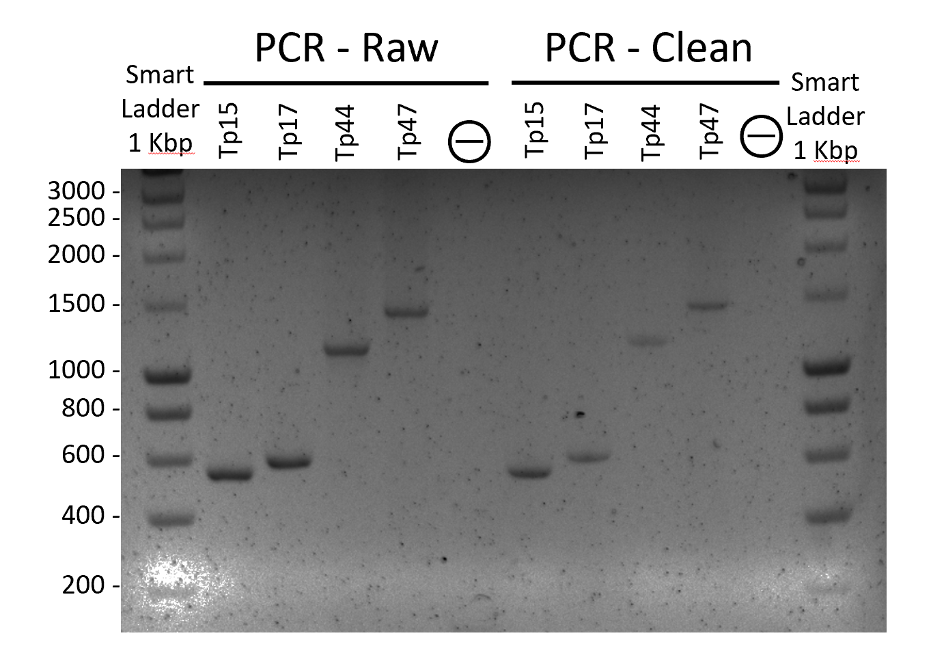
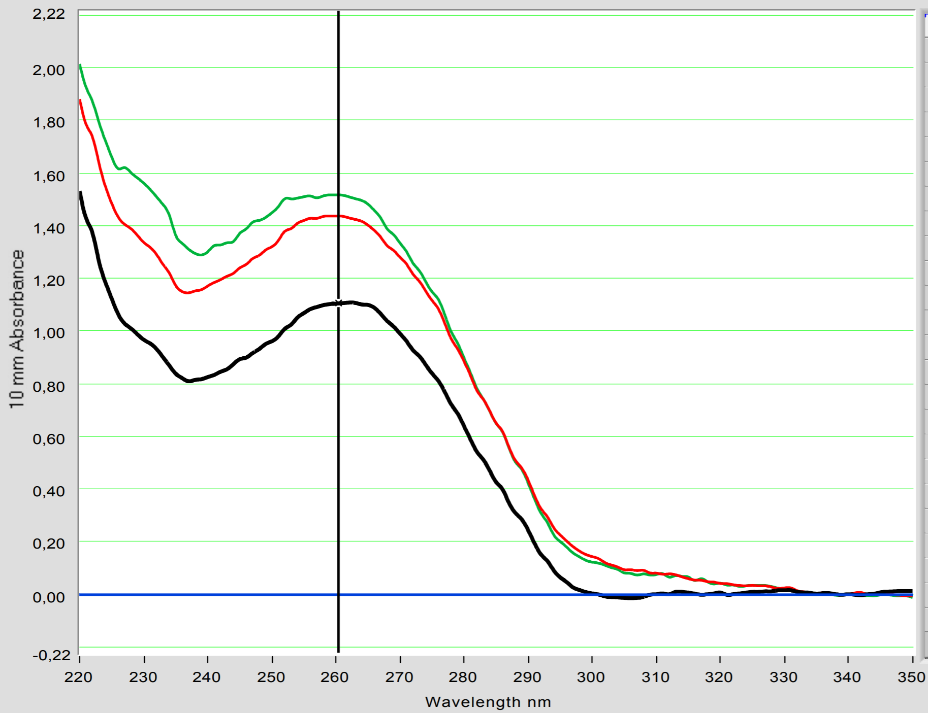
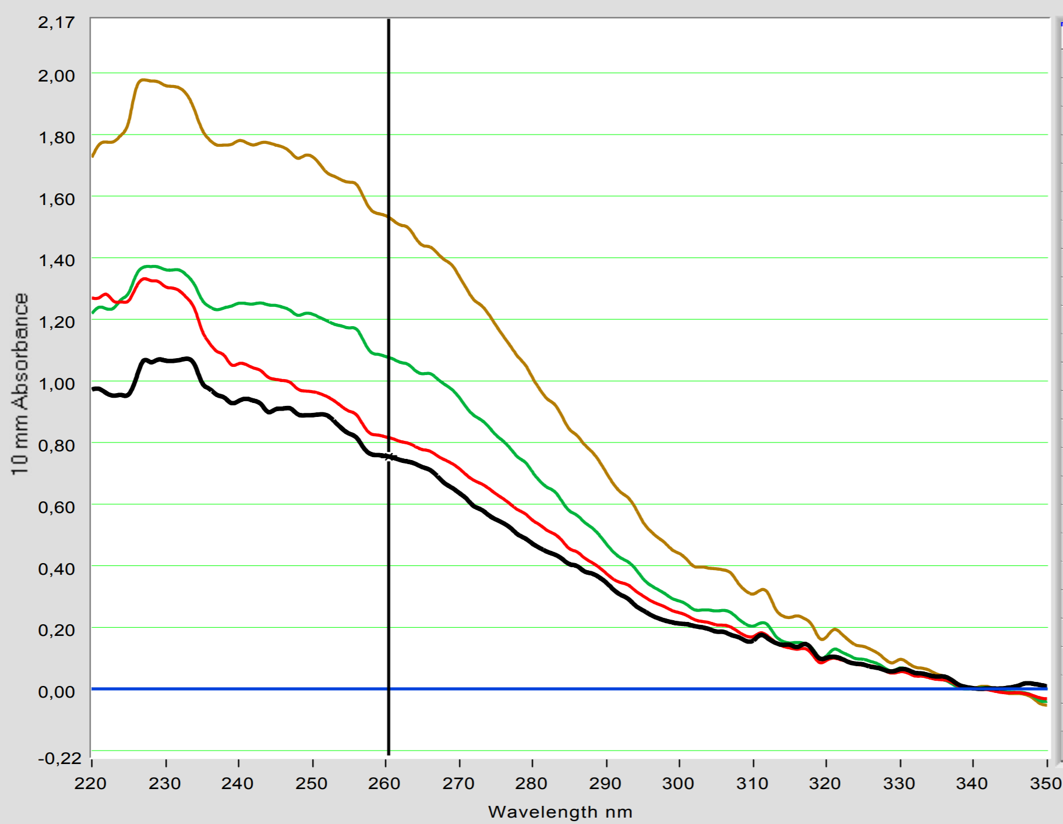
Preperation for Sequencing
Pre-sequencing ▶ PCR clean-up to remove primers, polymerase, etc
PCR - Raw
Update
Conc. Range: 55 – 79 ng/μl
PCR - Clean
Correct size fragments, slight DNA loss from the clean-up
Conc. Range: 37 – 76 ng/μl
Higher 230 nm peak, slight EtOH contamination?
Notes:
Pre-sequencing ▶ PCR clean-up to remove primers, polymerase, etc

Slide 33
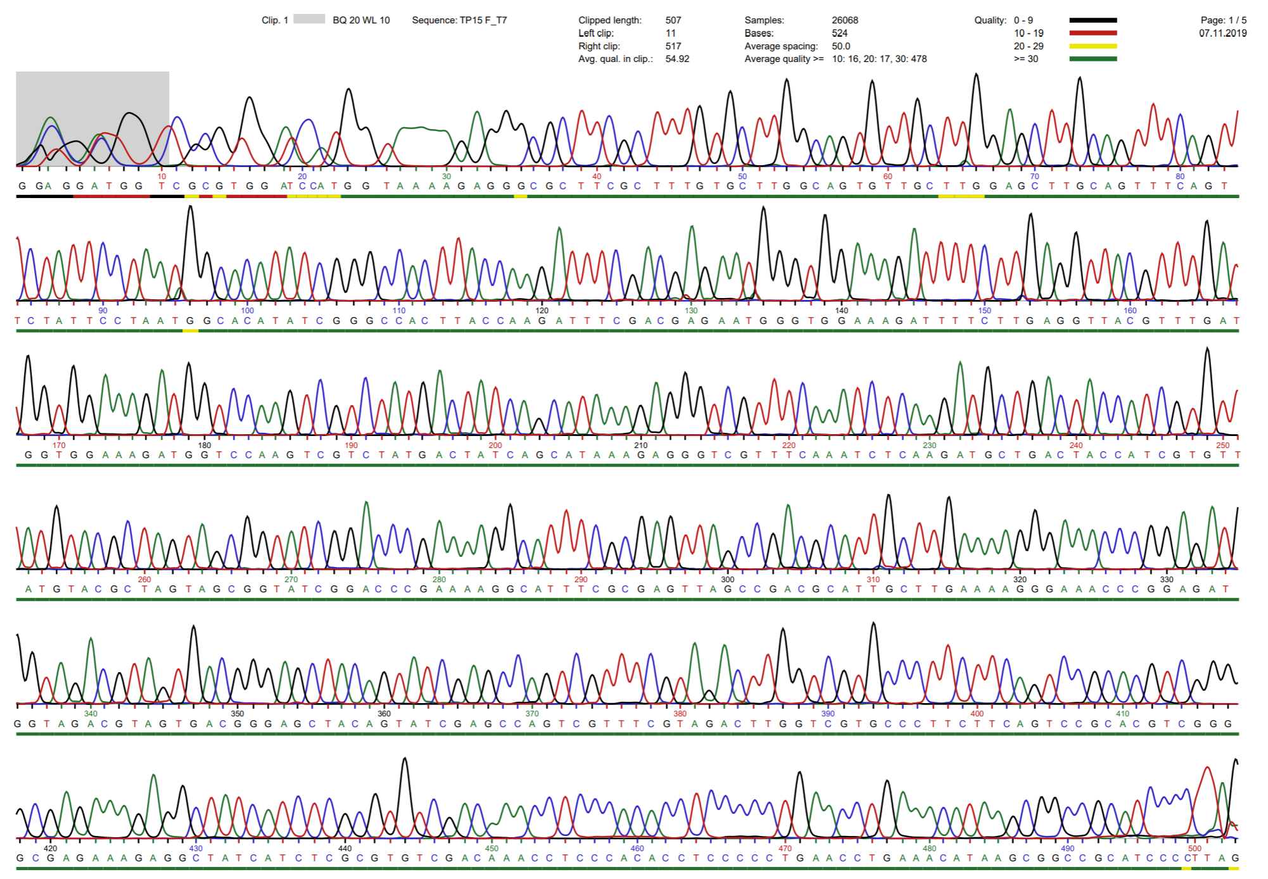
Sequencing
High quality among sequencing, except for 3’ ends

Slide 34

Sequencing Alignment
Low quality 3’ end ▶ sequence forward and reverse strands
After trimming, each sequence was identical to the reference
Notes:
Low quality 3’ end ▶ sequence forward and reverse strands

Slide 35


Optimization for Antigen Evaluation
Minimize the False Negatives & Positives for each antigen
Take consensus from antigen cutoffs
Check for statistical significance

Slide 36


Performance compared to single antigens
Multiple antigens used ▶ Increased sensitivity and specificity

Slide 37


Confounding factors – extreme outliers
Positive samples with < 10x the cut-off:
Negative samples with > 10x the cut-off:
◀︎ Dilution problem
Source: Matera et al.
Direct ELISA: 6 antigens ▶︎
Visual assessment ▶︎
Source: Mikrogen
Notes:
https://www.researchgate.net/publication/265299545_Chronic_neuroborreliosis_by_B_garinii_An_unusual_case_presenting_with_epilepsy_and_multifocal_brain_MRI_lesions

